Slide 1
Deep Learning with CNTK Azure Machine Learning Meetup May 25, 2017
Introduction to the CNTK
Sources and References at end of deck

Slide 2
I. what is CNTK II. how to use CNTK III. example source-code walkthrough

Slide 3
The Microsoft Cognition Toolkit (CNTK)
Microsoft’s open-source deep-learning toolkit
ease of use: what, not how
fast
flexible
Linux and Windows support
internal=external version

Slide 4
CNTK “Cognition Toolkit”
CNTK is Microsoft’s open-source, cross-platform toolkit for learning and evaluating deep neural networks.
CNTK expresses (nearly) arbitrary neural networks by composing simple building blocks into complex computational networks, supporting relevant network types and applications.
CNTK is production-ready: State-of-the-art accuracy, efficient, and scales to multi-GPU/multi-server.
http://cntk.ai

Slide 5
“CNTK is Microsoft’s open-source, cross-platform toolkit for learning and evaluating deep neural networks.”
open-source model inside and outside the company
created by Microsoft Speech researchers (Dong Yu et al.) in 2012; open-sourced (CodePlex) in early 2015
on GitHub since Jan 2016 under permissive license
“working out loud:” virtually all code development is out in the open
used by Microsoft product groups
CNTK-trained models power more and more Microsoft products
several teams have full-time employees on CNTK that actively contribute
external contributions e.g. from MIT and Stanford
Linux, Windows, docker, cudnn5
Python and C++ API ; followed by C#/.Net

Slide 6







deep learning at Microsoft
Microsoft Cognitive Services
Skype Translator
Cortana
Bing
HoloLens
Microsoft Research

Slide 7
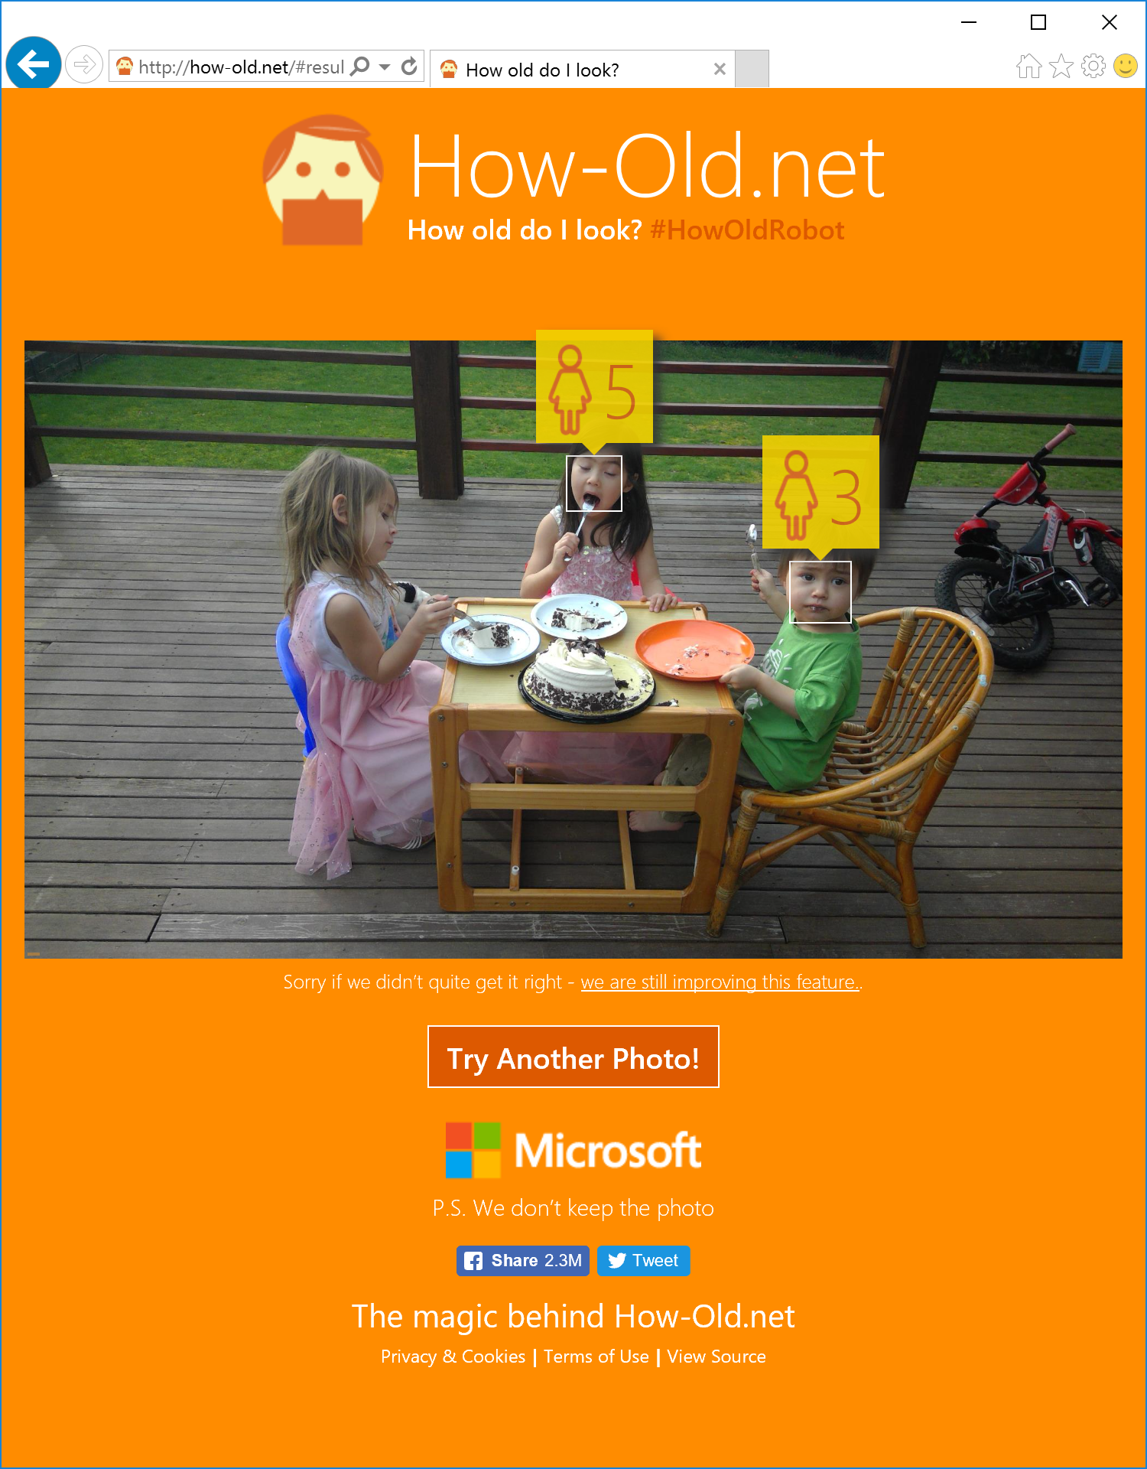
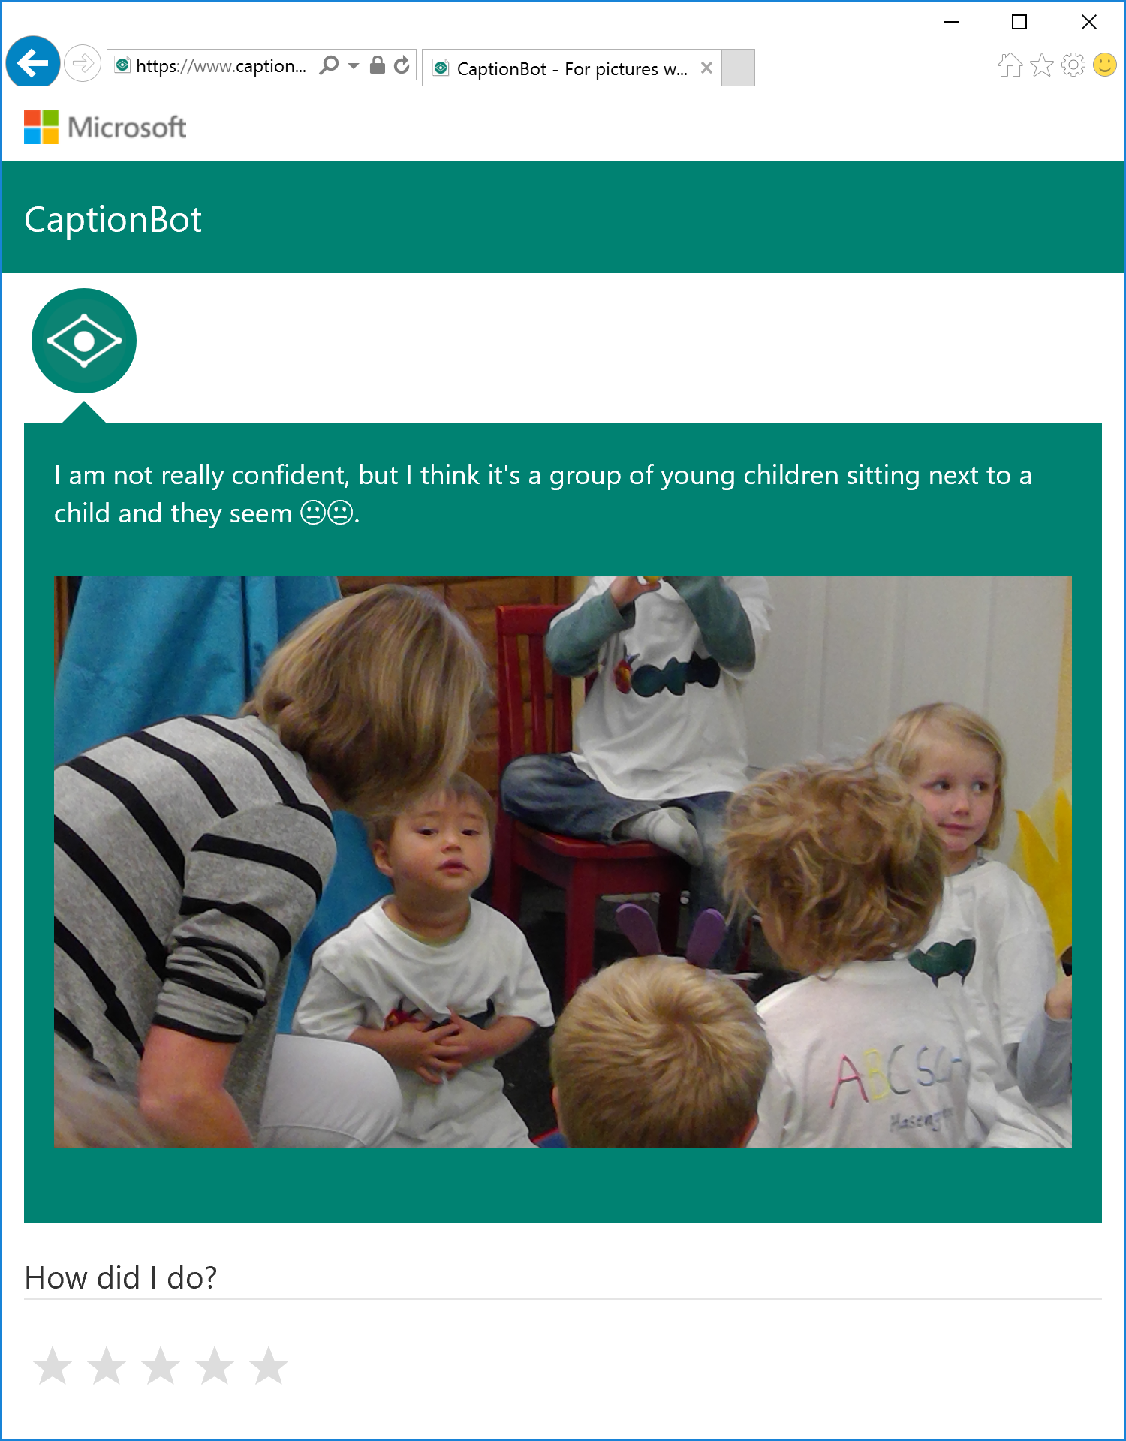

Slide 8
Goals for CNTK
Express neural and deep network designs via configuration files and or programming languages
Allow the designer to compose the network layering as they choose
Provide supporting input/output and logging capability
Offer batch and on-line capability
Offer desktop/cloud/GPU or CPU targeting

Slide 9
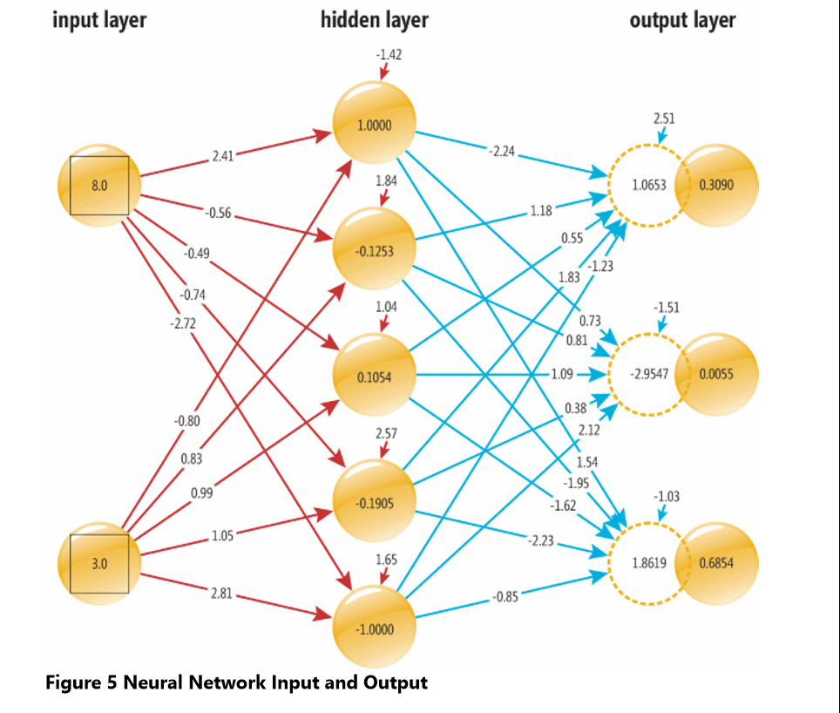
this is what we will define with CNTK two input nodes that hold values (8.0, 3.0) ; three output nodes with values(probabilities) (0.3090, 0.0055, 0.6854)

Slide 10
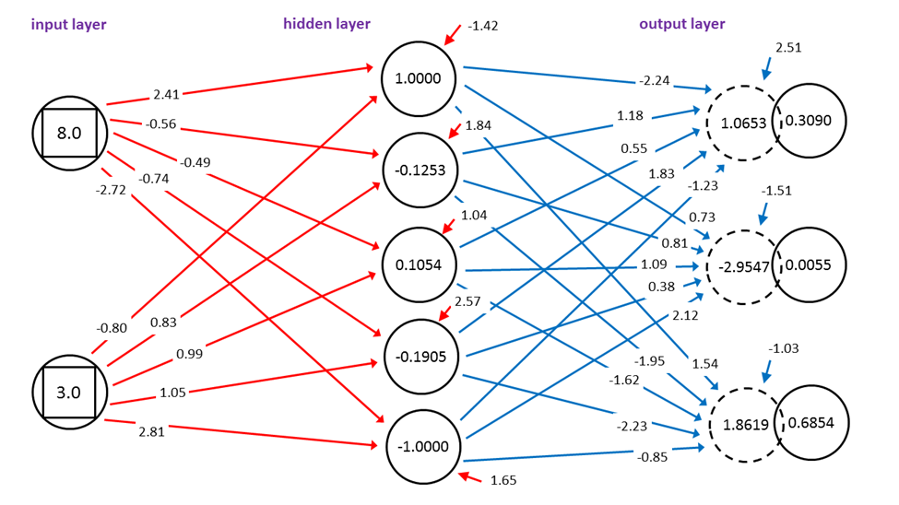
Corresponding output (dup of prior)

Slide 11
How to build, train, run models
Option 1 – use native BrainScript - a JSON like declarative description file
Option 2 – use a programming language (C++, Python) to provide structure, inputs, parameters etc.
For this session we’ll be using Option 1 – later sessions will use Python

Slide 12
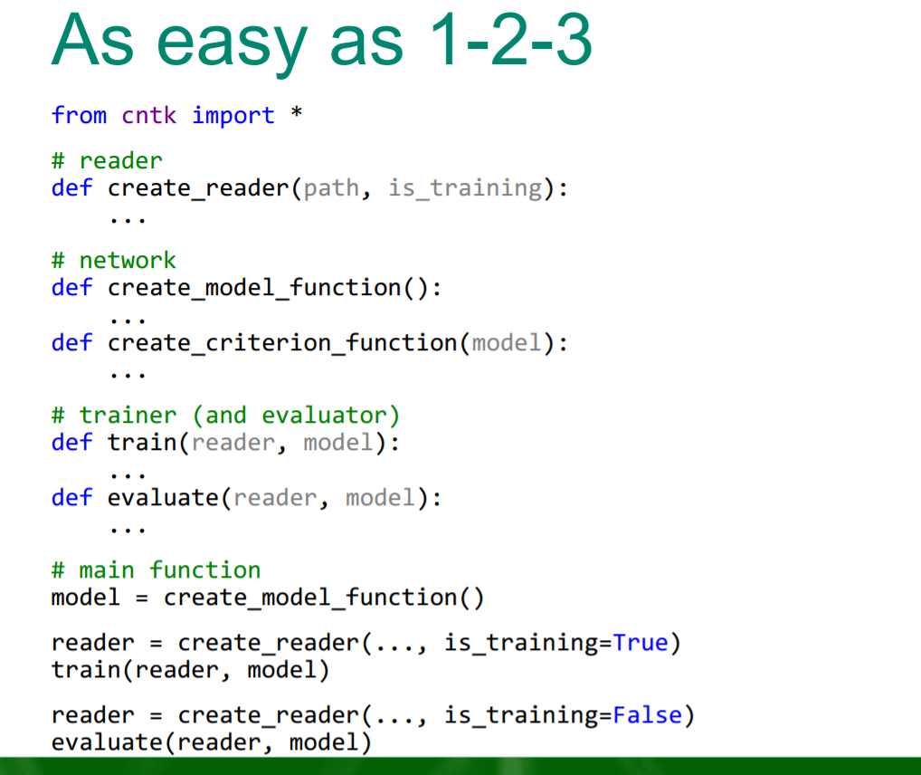
The Python View

Slide 13
how to: CNTK architecture
CNTK
reader
• task-specific deserializer
• automatic randomization
network
• network definition
• CPU/GPU execution engine
learner
• SGD (momentum, AdaGrad, …)
• minibatching, packing, padding
corpus
model

Slide 14
Let’s go through the process
To train a model:
cntk.exe configFile=MakeModel.cntk makeMode=false
Then we will use the model to make a prediction:
cntk.exe configFile=MakePrediction.cntk makeMode=false
All the details are in the configFile so let’s dig into it

Slide 15
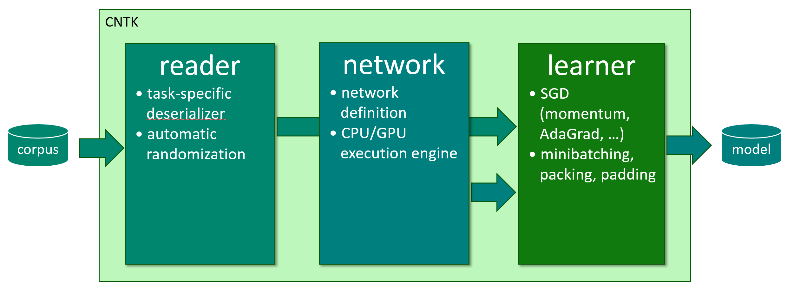
how to: top-level configuration shell
# MakeModel.cntk
command=Train:WriteProbs:DumpWeights:Test #think of these as modules to execute
# system parameters go here
Train = [ #Train module
action="train"
BrainScriptNetworkBuilder = [
# define network here
]
]
Test = [
# training commands here
]
WriteProbs = [
# output commands here
]
DumpWeights = [
# output commands here
]

Slide 16
how to: top-level configuration

Slide 17
how to: reader
Notes:
(just explain: (1) deserialization incl. IDeserializer and (2) auto-randomization)

Slide 18
how to: define/create network
# network description
BrainScriptNetworkBuilder = [
FDim = $dimension$
HDim = 5
LDim = $labelDimension$
# define the neural network
neuralDef (ftrs) = [
W0 = Parameter (HDim, FDim)
b0 = Parameter (HDim, 1)
W1 = Parameter (LDim, HDim)
b1 = Parameter (LDim, 1)
hn = Tanh (W0 * ftrs + b0)
zn = W1 * hn + b1
].zn
# specify inputs
features = Input (FDim)
labels = Input (LDim)
# create network
myNet = neuralDef (features)
Notes:
(just explain: (1) deserialization incl. IDeserializer and (2) auto-randomization)

Slide 19
how to: reader
Getting your data into CNTK:
standard formats: images, speech (HTK, Kaldi)
convert to CNTK Text Format
sed -e 's/^/<s> /' -e 's/$/ <\/s>/' < en.txt > en.txt1 sed -e 's/^/<s> /' -e 's/$/ <\/s>/' < fr.txt > fr.txt1 paste en.txt1 fr.txt1 | Scripts/txt2ctf.py --map en.dict fr.dict > ef.ctf
big data: implement custom deserializer in C++ or Python¹
small data: read with your favorite Python lib to RAM
Notes:
(just explain: (1) deserialization incl. IDeserializer and (2) auto-randomization)

Slide 20
Building a simple linear regression sample – input looks like (stored in TrainData.txt) one hot encoding of R G B (red,green,blue)
|features 1.0 1.0 |labels 1 0 0
|features 3.0 9.0 |labels 1 0 0
|features 8.0 8.0 |labels 1 0 0
|features 3.0 4.0 |labels 0 1 0
|features 5.0 6.0 |labels 0 1 0
|features 3.0 6.0 |labels 0 1 0
|features 8.0 3.0 |labels 0 0 1
|features 8.0 1.0 |labels 0 0 1
|features 9.0 2.0 |labels 0 0 1

Slide 21
Testdata.txt looks like
Test data used to validate the trained CNTK model
|features 1.0 1.0 |labels 1 0 0
|features 3.0 9.0 |labels 1 0 0
|features 8.0 8.0 |labels 1 0 0
|features 3.0 4.0 |labels 0 1 0
|features 5.0 6.0 |labels 0 1 0
|features 3.0 6.0 |labels 0 1 0
|features 8.0 3.0 |labels 0 0 1
|features 8.0 1.0 |labels 0 0 1
|features 9.0 2.0 |labels 0 0 1

Slide 22
Prediction data used (NewData.txt)
|features 4.0 7.0 |labels -1 -1 -1
Note: last data line must end in a CR/LF

Slide 23
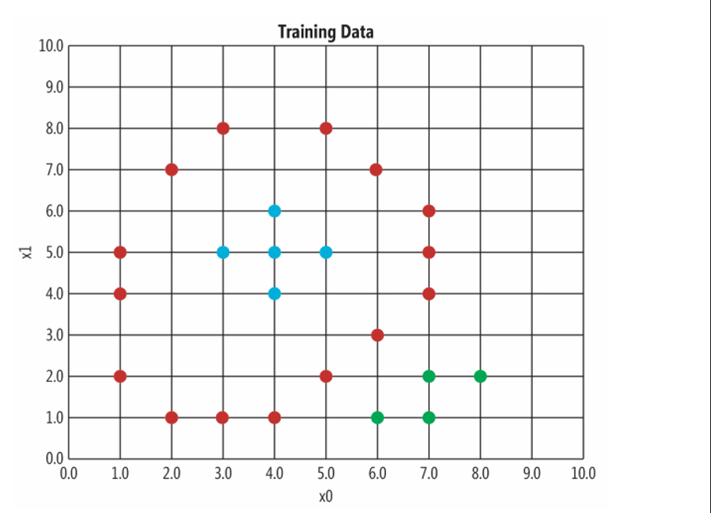
Graph of that Training Data – Colors indicate Output Label Value – note the visual pattern
Source: https://msdn.microsoft.com/en-us/magazine/mt791798.aspx

Slide 24
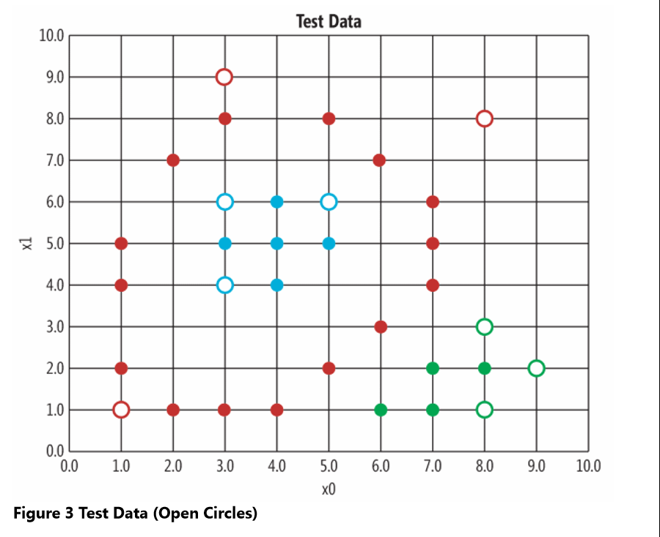
Same data as prior slide with Test Data added (open circle)

Slide 25
“CNTK expresses (nearly) arbitrary neural networks by composing simple building blocks into complex computational networks, supporting relevant network types and applications.”
example: 2-hidden layer feed-forward NN
h₁ = σ(W₁ x + b₁) h1 = Sigmoid (W1 * x + b1)
h₂ = σ(W₂ h₁ + b₂) h2 = Sigmoid (W2 * h1 + b2)
P = softmax(W_{out} h₂ + b_{out}) P = Softmax (Wout * h2 + bout)
with input x ∈ R^{M} and one-hot label y ∈ R^{J}
and cross-entropy training criterion
ce = y^{T} log P ce = CrossEntropy (y, P)
Σ_{corpus}ce = max

Slide 26
“CNTK expresses (nearly) arbitrary neural networks by composing simple building blocks into complex computational networks, supporting relevant network types and applications.”
ce
CrossEntropy
P
Softmax
b_{out}
+
h1 = Sigmoid (W1 * x + b1)
h2 = Sigmoid (W2 * h1 + b2)
P = Softmax (Wout * h2 + bout)
ce = CrossEntropy (y, P)
W_{out}
•
h₂
σ
b₂
+
W₂
•
h₁
σ
b₁
+
W₁
•
x
y

Slide 27
“CNTK expresses (nearly) arbitrary neural networks by composing simple building blocks into complex computational networks, supporting relevant network types and applications.”
ce
nodes: functions (primitives)
can be composed into reusable composites
edges: values
arbitrary-rank tensors with static and dynamic axes
automatic dimension inference
sparse-matrix support for inputs and labels
automatic differentiation
∂F / ∂in = ∂F / ∂out ∙ ∂out / ∂in
deferred computation → execution engine
optimized execution
memory sharing
editable, cloneable
CrossEntropy
P
Softmax
b_{out}
+
W_{out}
•
h₂
σ
b₂
+
W₂
•
h₁
σ
b₁
+
W₁
•
x
y

Slide 28
“CNTK expresses (nearly) arbitrary neural networks by composing simple building blocks into complex computational networks, supporting relevant network types and applications.”
Lego-like composability allows CNTK to support a wide range of networks, e.g.
feed-forward DNN
RNN, LSTM
convolution
sequence-to-sequence
for a range of applications including
speech
vision
text
and combinations
Layers Library of predefined building blocks: https://www.cntk.ai/pythondocs/layerref.html

Slide 29
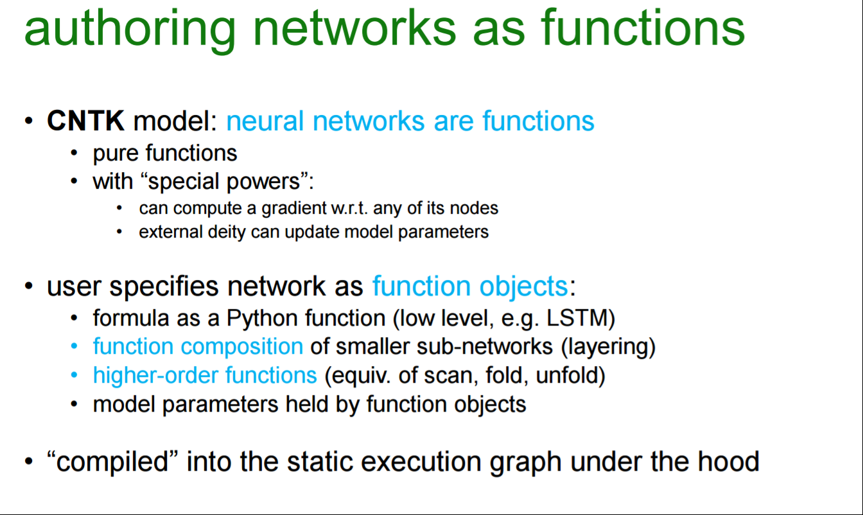

Slide 30
III. example

Slide 31
running: CNTK architecture
CNTK
reader
• task-specific deserializer
• automatic randomization
network
• network definition
• CPU/GPU execution engine
learner
• SGD (momentum, AdaGrad, …)
• minibatching, packing, padding
corpus
model

Slide 32
Runs to try
Default train and test
cntk.exe configFile=MakeModel.cntk makeMode=false
Prediction (create a NewData.txt) and MakePrediction.cntk
cntk.exe configFile=MakePrediction.cntk makeMode=false
Try adding more new rows to NewData.txt
How do I examine the output?

Slide 33
Examining outputs and logs
Your config file should have a line:
stderr ="Log" #all messages to a file in working directory
Outputs (predictions) go to:
outputPath ="Prediction.txt" #dump with pn extension
Prediction.txt.pn will look like: ( I used 3 new entries in NewData.txt)
0.285298 0.714658 0.000044 (green predicted)
0.280534 0.719422 0.000044 (green predicted)
0.995119 0.004881 0.000000 (red predicted)

Slide 34
NewData.txt content
|features 4.0 7.0 |labels -1 -1 -1
|features 5.0 6.0 |labels -1 -1 -1
|features 1.0 8.0 |labels -1 -1 -1

Slide 35
MAKEPREDICTION.CNTK (1 of 3)
# MakePrediction.cntk
stderr ="Log" #all messages to a file
command=Predict:WriteProbs
modelPath = "Model\SimpleNet.snn"
deviceId = -1 #(CPU only)
dimension = 2
labelDimension = 3
Precision = "float"

Slide 36
MakePrediction.cntk (2 of 3)
Predict = [
action = "eval"
reader = [
readerType="CNTKTextFormatReader"
file="NewData.txt"
input = [
features = [ dim = $dimension$; format = "dense" ]
labels = [ dim = $labelDimension$; format = "dense" ]
]
]
]

Slide 37
MakePrediction.cntk (3 of 3)
WriteProbs = [
action = "write"
reader = [
readerType = "CNTKTextFormatReader"
file="NewData.txt"
input = [
features = [ dim = $dimension$; format = "dense" ]
labels = [ dim = $labelDimension$; format = "dense" ]
]
]
outputPath ="Prediction.txt" #dump with pn extension
]

Slide 38
Can I run this on my own
All the info needed and supporting article:
https://msdn.microsoft.com/en-us/magazine/mt791798.aspx
Cntk files and inputs etc will be posted to GitHub
https://github.com/jimwill3/NY-AZML-Meetup
Getting CNTK for your own usage:
http://Aka.ms/dsvm – use the Azure Data Science Virtual Machine (windows,linux)
http://Cntk.ai - follow links to the GitHub location to install locally (windows,linux)
https://msdn.microsoft.com/en-us/magazine/mt791798.aspxrning-and-Data-Sciences-Conference/Data-Science-Summit-2016/MSDSS15

